Slide 1
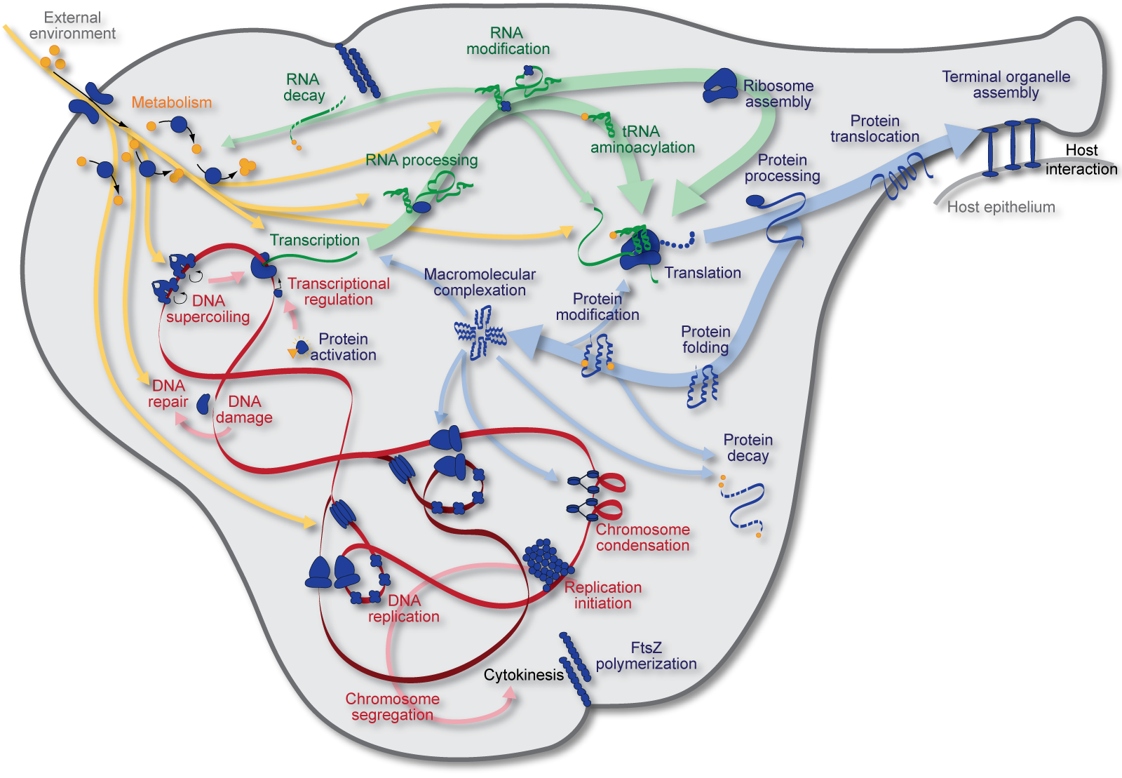

Whole-cell modeling
KarrLab.org
karr@mssm.edu
Jonathan Karr
April 7, 2016

Slide 2
Outline
Introduction
Goals
Approaches
Multi-algorithm simulation
Parameter estimation, verification, best practices
Exercises
Model building
Parameter estimation
Multi-algorithm simulation
Submodel simulation
Model annotation

Slide 3
Introduction

Slide 4
Motivation: Comprehensively understand and manipulate cells

Slide 5
Goals
Represent multiple pathways with different structures and dynamics
Represent well- and poorly-characterized pathways
Integrate heterogeneous data
Train models from incomplete and noisy data
Integrate molecular information over many orders of length and time

Slide 6
Approaches
Data-based
Physics-based
Based on observed phenotypes
Simpler mathematical formulation
Easier to construct
Limited ability to extrapolate beyond training data
Based on known biochemistry and biophysics
Complex, non-linear mathematics
Time-consuming to construct
Uses universal physical to extrapolate beyond training data

Slide 7
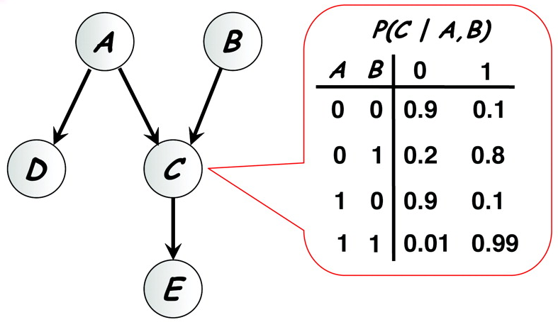
Data-based approaches: Bayesian models
Friedman, 2004

Slide 8
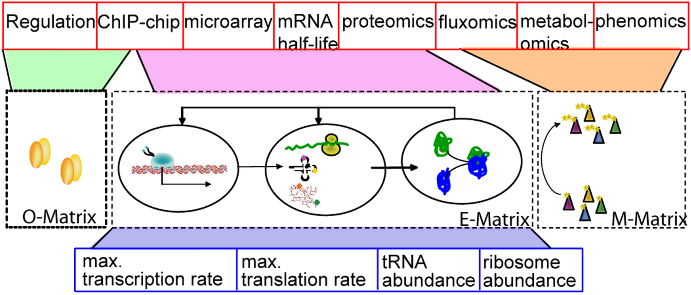
Phenomenological approaches: FBA
Chandrasekaran et al., 2010

Slide 9
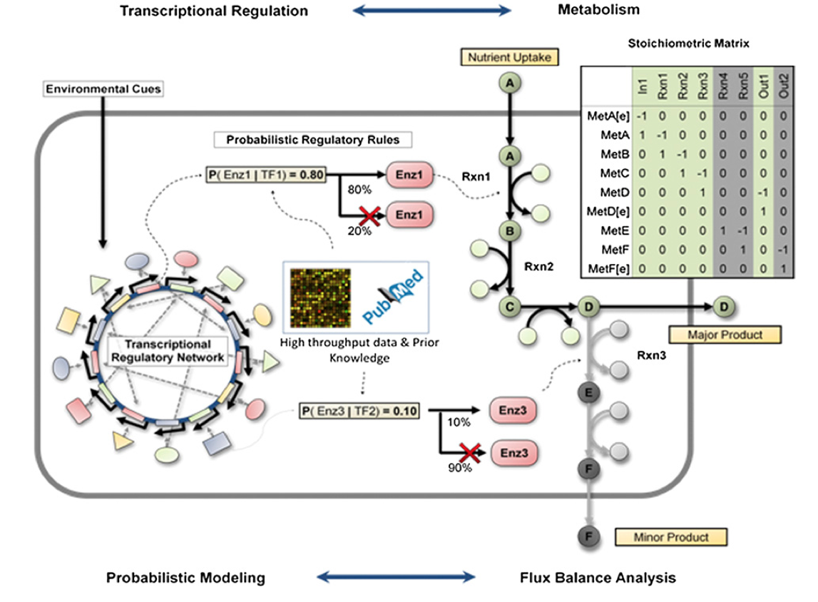
Phenomenological approaches: PROM
Chandrasekaran et al., 2010

Slide 10
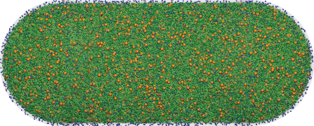
Mechanistic approaches: Coarse-grained MD
Roberts et al., 2012

Slide 11
Mechanistic modeling formalisms
Boolean
FBA
Scope
ODE
PDE
Gillespie
Accuracy

Slide 12
Multi-algorithm modeling
Uptake
FBA
Composition
Models composed of submodels
Submodels describe individual pathways
Submodels represented using different math
Enables representation of well- and poorly-studied pathways
Metabolism
FBA
Composition
Transcription
Stochastic binding
Gene expression
Translation
Stochastic binding
Gene expression
Replication
Chemical kinetics
DNA sequence

Slide 13
Synonyms
Uptake
FBA
Model composition
Integrative modeling
Hybrid modeling
Multi-algorithm modeling
Multi-physics modeling
Hierarchical modeling
Composition
Metabolism
FBA
Composition
Transcription
Stochastic binding
Gene expression
Translation
Stochastic binding
Gene expression
Replication
Chemical kinetics
DNA sequence

Slide 14
Advantages of multi-algorithm models
Advantages
Disadvantages
Model composition
Encapsulates pathways
Enables collaborative model design, estimation, and testing
Combines coarse- and fine-grained submodels
Enables thorough representation of knowledge and data
Avoids unknown parameters
Simplifies parameter estimation
Enables more comprehensive and more accurate models
Few established methods and software
Challenging to build, simulate, identify and verify
Require expert knowledge and intense effort

Slide 15
WC modeling building
Uptake
Mass, shape
FBA
Composition
Curate data
Construct submodels
Define global state
Combine submodels
Simulate
Metabolite, RNA, protein counts
Metabolism
FBA
Composition
Transcript, polypeptide seqs
Transcription
Stochastic events
Gene expression
DNA polymerization,
proteins, modifications
Translation
Stochastic events
Gene expression
Septal ring
Replication
Chemical kinetics
DNA sequence
Host
Submodels
States

Slide 16
Model consistency
Utilize same species, reaction names
Resolve conflicting species/reaction representations across submodels
Calculate RNA and protein sequences from gene sequences
Calculate species molecular weights from structures
Calculate transcription, translation, RNA degradation reactions from sequences
Calculate cell mass, volume from species counts and molecular weights

Slide 17
Reproducibility
Every model element should defined without references to external databases
Metabolites: InCHI, SMILES
RNA, protein: sequences
Reactions: stoichiometry
Cross references should be provided where possible
Metabolites: ChEBI
RNA: NCBI
Proteins: UniProt
Reactions: EC numbers
Every data source and model assumption should be recorded

Slide 18
Multi-algorithm simulation
Area of active research
A few algorithms have been developed
All have limitations
Tutorial: foundational concepts

Slide 19
Multi-algorithm simulation
Uptake
Uptake
Uptake
Metabolism
Metabolism
Metabolism
Cell states
Cell states
Cell states
Transcription
Transcription
Transcription
Translation
Translation
Translation
Replication
Replication
Replication
1 s
Assumption: pathways are independent over short time periods
Notes:
Our model is then executed by first executing 28 individual models of cellular processes at a 1 s time scale, second integrating the inputs and outputs of the individual models, for example, and finally repeating this process tens of thousands of times across the length of the Mycoplasma genitalium cell cycle.

Slide 20
Concurrent submodel integration
Approximate/continuous/timestep
Simulate models over short timesteps
Synchronize models between timesteps
Low computational cost
Low numerical accuracy
Exact/discrete
Resolve order of every individual reaction
Synchronize submodels after every reaction
High computational cost
High numerical accuracy

Slide 21
Approximate simulation
Divide time into small steps
Integrate submodels separately
Update global state
Reduce timestep until results converge

Slide 22
Submodel execution order
Asynchronous integration
Synchronous integration
Cell states
…
Cell states
Cell states

Slide 23
Exact simulation
Based on SSA
Where possible, convert submodels to discrete submodels and simulate using SSA
Simulate ODE with SSA
Add explicit time to Boolean models
Merge SSA submodels
Discretely schedule continuous submodel updates
Treat continuous submodels as a single discrete pseudoreaction whose stoichiometry is time-variant

Slide 24
Exact simulation
Requires resolution of many events
Computationally expensive
Implement using parallel discrete event simulation

Slide 25
Parameter estimation
Compare model to experimental data
Numerically minimize prediction error
Theory provides additional constraints

Slide 26
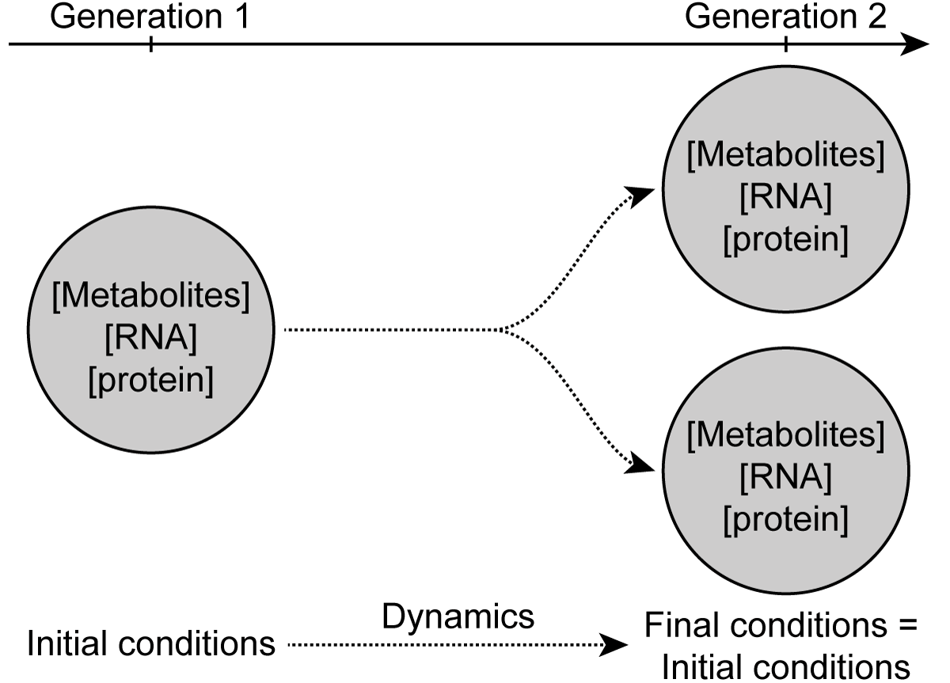
Cell theory provides periodic boundary constraint

Slide 27
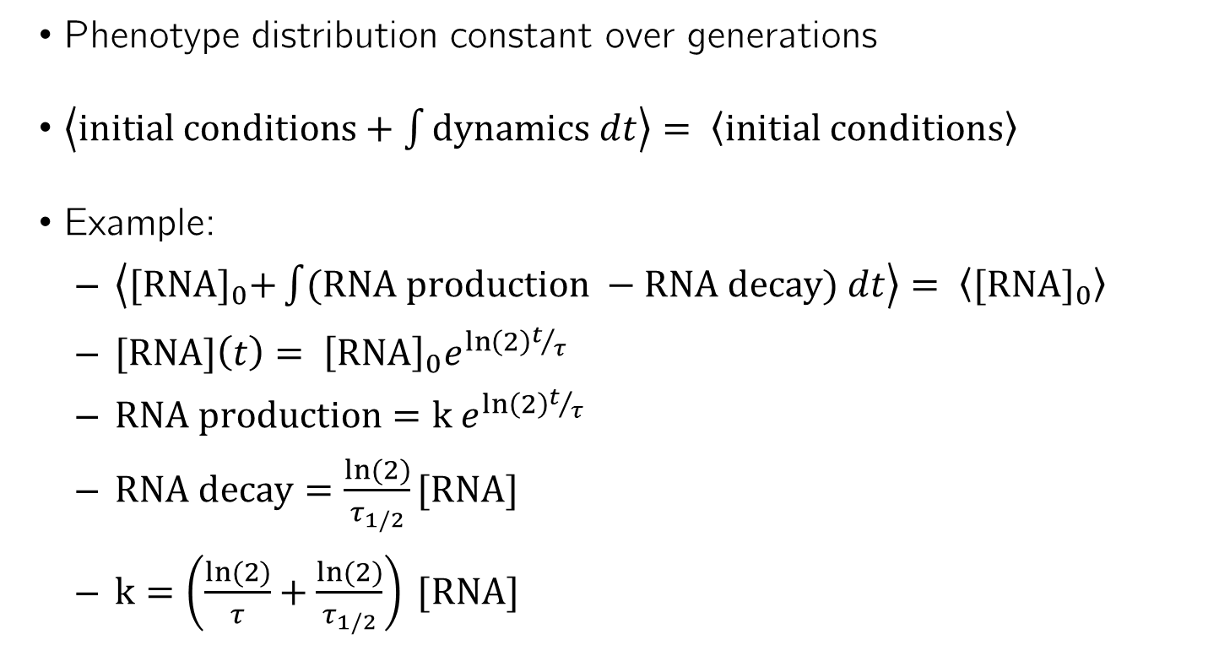
Cell theory provides periodic boundary constraint
Phenotype distribution constant over generations
$\left\langle initial conditions+\int{dynamics dt}\right\rangle = \left\langle initial conditions\right\rangle$
Example:
$\left\langle {[RNA]}_{0}+\int{(RNA production −RNA decay) dt}\right\rangle = \left\langle {[RNA]}_{0}\right\rangle$
$[RNA]\left(t\right)= {\left[RNA\right]}_{0}e^{\ln\left(2\right)t/τ}$
$RNA production=k{ e}^{\ln\left(2\right)t/τ}$
$RNA decay=\frac{ln⁡(2)}{τ_{1/2}}[RNA]$
$k=\left(\frac{ln⁡(2)}{τ}+\frac{ln⁡(2)}{τ_{1/2}}\right) [RNA]$

Slide 28
Verification
Statically verify model
E.g. all reactions mass and charge balanced
Dynamically verify submodels
E.g. protein content doubles over cell cycle duration
Dynamically verify entire model
E.g. cell divides in observed doubling time

Slide 29
Software engineering
Organization
Uses methods, objects, and modules to encapsulate data and procedures
Repository used to track revisions
Style
Clearly and consistently named variables, methods, classes
Annotation
Author name, last updated date
Commented
Testing
Code is tested formally using unit testing
Tests evaluated at each revision using continuous integration

Slide 30
Exercises

Slide 31
Exercises
Model building
Assemble a small WC model from several data points
Model alignment and parameter estimation
Use cell theory to identify parameter values
Multi-algorithm simulation
Implement hybrid FBA/SSA simulator
Individual submodel simulation
Simulation single submodel
Best practices
Annotate model

Slide 32
Physiology
Model reflects typical cell biology
Motivated by M. pneumoniae

Slide 33
Submodels
 | Algorithm | Reactions | Enzymes
Metabolism | FBA | Several | Several
Transcription | SSA | 1 per RNA | RNA polymerase
Translation | SSA | 1 per protein | Ribosome
RNA degradation | SSA | 1 per RNA | Rnase

Slide 34
Metabolism submodel
Metabolite | Biomass | Produce for other pathways | Recycle from other pathways | Import from media
Glucose |  |  |  | Y
Nucleobases |  |  |  | Y
NMPs | Y |  | Y
GDP | Y |  | Y
NTPs | Y | Y
Amino acids | Y | Y |  | Y
NAD |  |  |  | Y
PPi | Y |  | Y
Pi | Y |  | Y | Y
H₂O | Y | Y | Y | Y
H⁺ | Y |  | Y | Y
O₂ |  |  |  | Y
CO₂ |  |  |  | Y
Internal metabolites

Slide 35
Non-metabolic submodels
Transcription
a ATP + c CTP + g GTP + u UTP + H₂O → RNA + l PPi + H⁺
l = a + c + g + u
Translation
a Ala + c Cys + … + y Tyr + (2 l + 3) GTP + (l + 4) H₂O → Protein + (2 l + 3) GDP + (2 l + 3) Pi + (2 l + 3) H⁺
RNA degradation
RNA + (l – 1) H₂O → a AMP + c CMP + g GMP + u UMP + (l - 1) H⁺

Slide 36
Species
Enzymes needed for submodels
RNA
Protein
Metabolic reactants and byproducts of all submodels
Amino acids
NTPs
NDPs
NMPs
PPi
Pi
H2O
H+

Slide 37
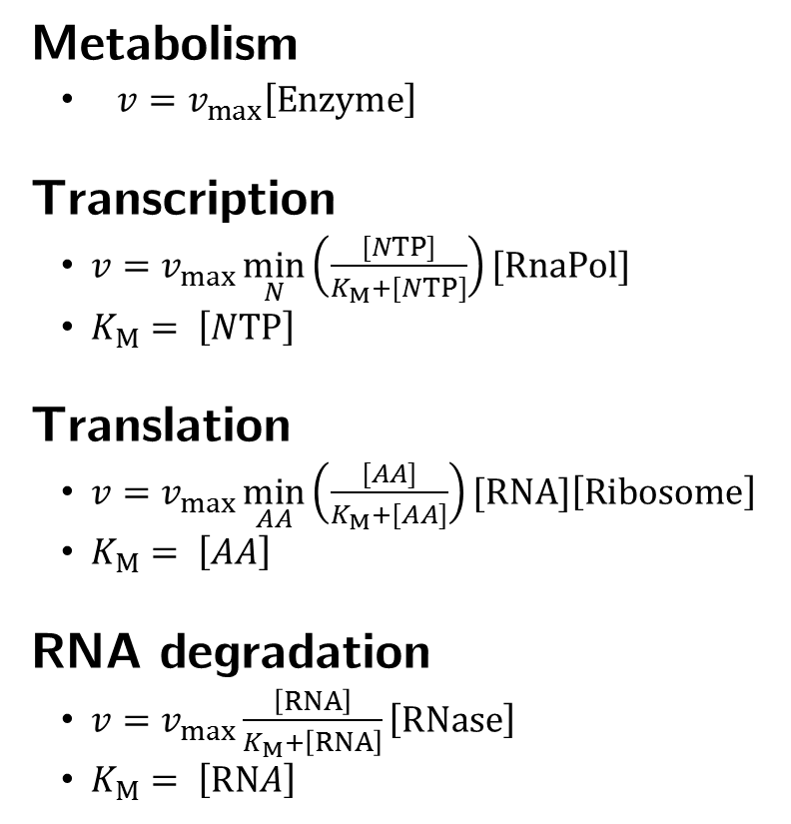
Rate laws
Metabolism
${v=v}_{max}\left[Enzyme\right]$
Transcription
$v=v_{max}\min_{N}\left(\frac{[NTP]}{K_{M}+[NTP]}\right)[RnaPol]$
$K_{M}= \left[NTP\right]$
Translation
$v=v_{max}\min_{AA}\left(\frac{[AA]}{K_{M}+[AA]}\right)[RNA]\left[Ribosome\right]$
$K_{M}= \left[AA\right]$
RNA degradation
$v=v_{max}\frac{\left[RNA\right]}{K_{M}+\left[RNA\right]}\left[RNase\right]$
$K_{M}= \left[RNA\right]$

Slide 38
Files
File | Description
Model.xlsx | Template model description and data to build model
excercise*.py | Template code for exercises
model.py | Reads model from Excel into Python object
analysis.py | Plots simulation results
util.py | Utility methods

Slide 39
Implementation: Classes
Model represented by Model object
Submodels
Species/compartments
Reactions
Compartments
Species
Reactions
Participants
Species
Compartment

Slide 40
Implementation: Methods
model.getModelFromExcel(<fileName:string>) Reads model from Excel
model.Model.calcInitialConditions() Calculates initial conditions
model.Submodel.updateLocalState(<model:Model>), model.Submodel.updateGlobalState(<model:Model>) Updates submodel state from model, updates global state from submodel
model.Submodel.calcReactionRates(<reactions:list>, <speciesConcentrations:dict>) Returns array with rates of every reaction in a submodel
model.FbaSubmodel.calcBounds(<timeStep:int>) Returns array with upper and lower bounds for reactions
model.Submodel.executeReaction(<speciesCounts:dict>, <reaction:Reaction>) Updates species counts with stoichiometry of the reaction
model.Model.calcMass(), model.Model.calcVolume() Updates cell mass and volume

Slide 41
Implementation: Cell state
model.Model.speciesCounts Represents species copy numbers as numpy array
Rows represent species
Columns represent compartments
model.Submodel.speciesCounts Represents species copy numbers as dict
model.Model.getSpeciesCountsDict(), model.Model.setSpeciesCountsDict(<counts:dict>) Gets, sets dict of species counts
model.Model.getSpeciesConcentrations(), model.Submodel.getSpeciesConcentrations() Gets species concentrations
model.Model.mass, model.Model.volume, model.Model.extracellularvolume, model.Submodel.volume, model.Submodel.extracellularVolume Cell mass, cell volume, extracellular volume
model.FbaSubmodel.growth, model.FbaSubmodel.reactionFluxes Growth rate and reaction fluxes

Slide 42
Implementation: Methods
model.Model.getComponentById(<id:string>) Returns model component with id
model.Reaction.getStoichiometryString() Returns string representation of reaction
analysis.plot( <model:Model>, <time:numpy.ndarray>, <volume:numpy.ndarray>, <speciesCounts:numpy.ndarray>, <selectedSpeciesCompartments: list of ids e.g. “ATP[c]”>, <units:str e.g. “mM”>, <fileName:str>) Plots simulation results
numpy.random.seed(<seed:int>) Seeds PRNG

Slide 43
Exercise 1: Building models from data
Learn how to build WC models from data
Build list of species, reactions from metabolic reconstruction
Use transcription, translation, RNA degradation templates to create individual reactions
Enumerate initial conditions from RNA and metabolite copy numbers/concentrations

Slide 44
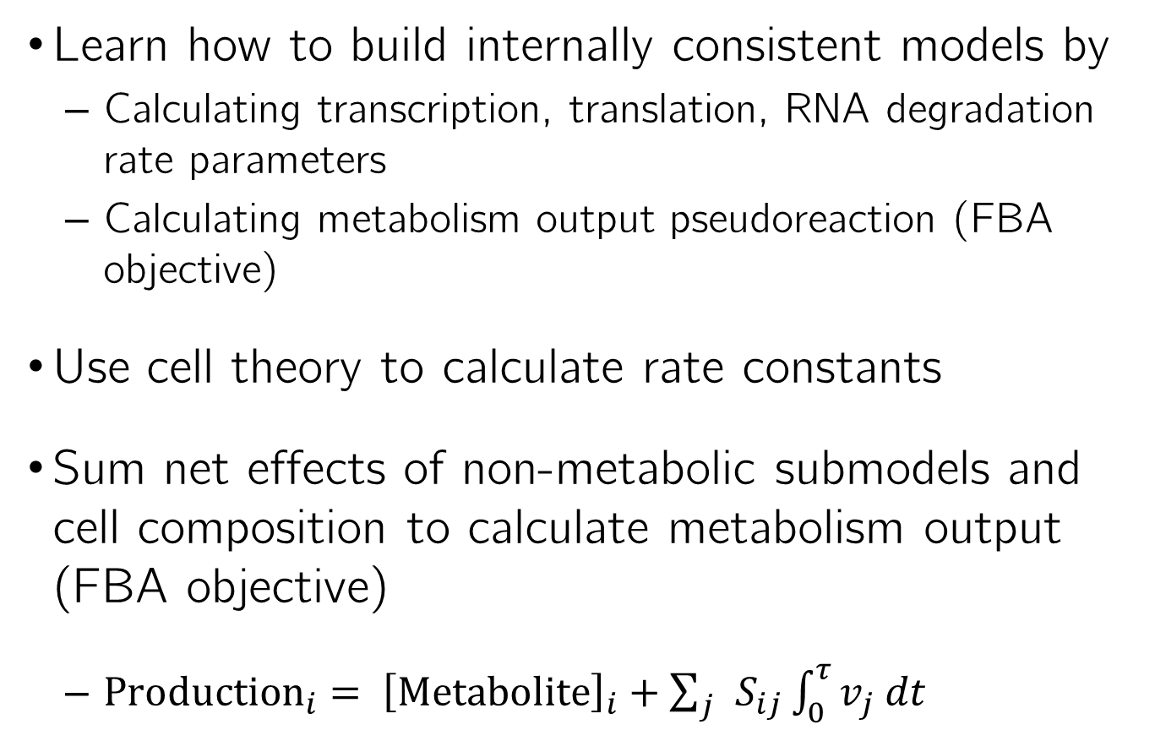
Exercise 2: Aligning submodels
Learn how to build internally consistent models by
Calculating transcription, translation, RNA degradation rate parameters
Calculating metabolism output pseudoreaction (FBA objective)
Use cell theory to calculate rate constants
Sum net effects of non-metabolic submodels and cell composition to calculate metabolism output (FBA objective)
${Production}_{i}= {\left[Metabolite\right]}_{i}+\sum_{j}{S_{ij}\int_{0}^{τ}{v_{j} dt}}$

Slide 45
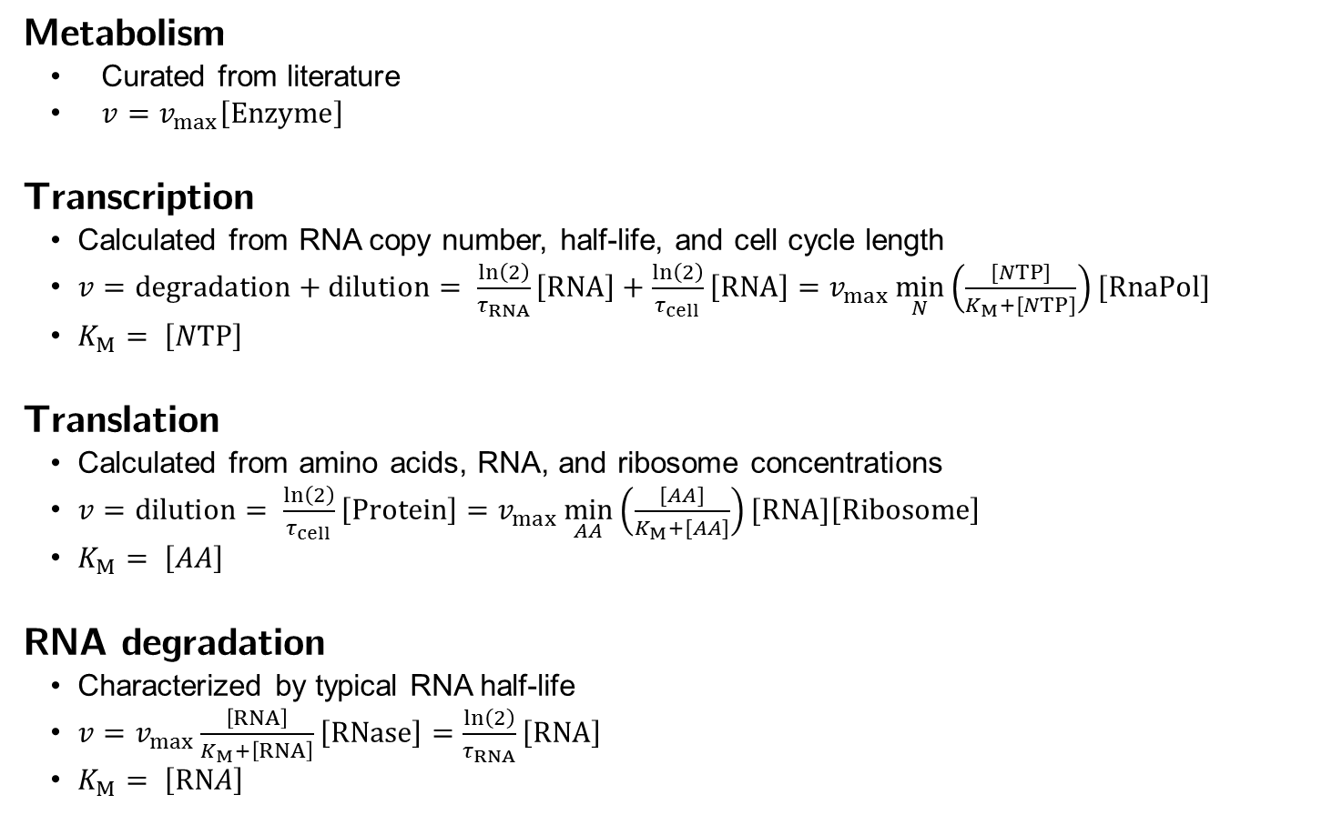
Rate parameters
Metabolism
Curated from literature
${v=v}_{max}\left[Enzyme\right]$
Transcription
Calculated from RNA copy number, half-life, and cell cycle length
$v=degradation+dilution= \frac{\ln\left(2\right)}{τ_{RNA}}\left[RNA\right]+\frac{\ln\left(2\right)}{τ_{cell}}\left[RNA\right]=v_{max}\min_{N}\left(\frac{[NTP]}{K_{M}+[NTP]}\right)[RnaPol]$
$K_{M}= \left[NTP\right]$
Translation
Calculated from amino acids, RNA, and ribosome concentrations
$v=dilution= \frac{\ln\left(2\right)}{τ_{cell}}\left[Protein\right]=v_{max}\min_{AA}\left(\frac{[AA]}{K_{M}+[AA]}\right)[RNA]\left[Ribosome\right]$
$K_{M}= \left[AA\right]$
RNA degradation
Characterized by typical RNA half-life
$v=v_{max}\frac{\left[RNA\right]}{K_{M}+\left[RNA\right]}\left[RNase\right]=\frac{\ln\left(2\right)}{τ_{RNA}}\left[RNA\right]$
$K_{M}= \left[RNA\right]$

Slide 46
Rate parameters
Submodel | Vmax | Km (mM)
Metabolism | Given | N/A
Transcription | 2.33 × 10⁻⁴ s⁻¹ | 1.00
Translation | 2.66 × 10² M⁻¹ s⁻¹ | 5.00
RNA degradation | 2.31 × 10⁻⁴ s⁻¹ | 1.81 × 10⁻⁴

Slide 47
Metabolism production
Metabolite | Molecules/cell | Metabolite | Molecules/cell
ALA | 3.42 × 10⁴ | PHE | 2.39 × 10⁴
ARG | 4.09 × 10⁴ | PRO | 3.44 × 10⁴
ASN | 2.32 × 10⁴ | SER | 4.45 × 10⁴
ASP | 2.43 × 10⁴ | THR | 3.62 × 10⁴
ATP | 1.10 × 10⁶ | TRP | 2.22 × 10⁴
CTP | 1.16 × 10⁶ | TYR | 2.20 × 10⁴
CYS | 2.23 × 10⁴ | UTP | 1.13 × 10⁶
GLN | 2.47 × 10⁴ | VAL | 3.38 × 10⁴
GLU | 2.27 × 10⁴ | AMP | -1.04 × 10⁶
GLY | 3.12 × 10⁴ | CMP | -1.10 × 10⁶
GTP | 1.73 × 10⁶ | GDP | -5.81 × 10⁵
H2O | 1.52 × 10⁹ | GMP | -1.05 × 10⁶
HIS | 2.16 × 10⁴ | H | -4.97 × 10⁶
ILE | 2.93 × 10⁴ | PI | -4.71 × 10⁵
LEU | 4.12 × 10⁴ | PPI | -4.38 × 10⁶
LYS | 2.20 × 10⁴ | UMP | -1.07 × 10⁶
MET | 2.14 × 10⁴

Slide 48
Exercise 3: Multi-algorithm simulation
Goal
Learn how to simulate multi-algorithm models by
Implementing a simulator for FBA and SSA
Approach
Combine non-metabolic submodels into a single submodel
Synchronize state between FBA and SSA models
Use SSA and FBA and simulate the combined model

Slide 49
Psuedocode
Initialize state
for t = 0; t < tMax; t+= dt
Simulate SSA submodels for dt
t2=t
Calculate SSA reaction rates
Calculate time to next SSA reaction
dt2 = exponential(sum(rates))
Calculate next SSA reaction:
multinomial(rates)
Update time: t2 = t2 + dt2
Update state
Simulate FBA submodel
Calculate growth rate
Update state

Slide 50
Exercise 4: Testing submodels
Goal
Learn how to test individual submodels so that submodels can be developed separately by
Testing metabolism submodel in a meaningful way without simulating the other submodels
Approach
Simulate metabolism submodel coupled with other reduced or “mocked” versions of the other submodels
The other submodels can be mocked by replacing them with a single pseudoreaction with represents their net effect

Slide 51
Pseudocode
Calculate net transcription, translation, RNA degradation reactions
Initialize state
t = 0
while t < tMax
Calculate growth and fluxes
Update state
Update sate by growth * net transcription, translation, RNA degradation reactions
Update time: t=t+dt

Slide 52
Exercise 5: Best practices
Learn and reinforce best WC modeling practices by
Annotating model with cross references
Calculating chemical formulae, molecular weights from structures
Testing model
Use ChEBI, Enzyme, NCBI, and UniProt to annotate species and reactions
Use ChEBI to annotate metabolite structures
Use mcule to calculate chemical formulae, molecular weights, charges

Slide 53
Summary
Definition | Represent well- and poorly-characterized pathways
Motivation | Represent well- and poorly-characterized pathways
Advantages | Enables comprehensive models
Disadvantages | Complex, few methods and tools
Construction | Map submodels onto common state
Simulation | Concurrently integrating submodels
Outlook | Research needed to develop simulation algorithms
Submodels
States

Slide 54




Acknowledgements
Yin Hoon Chew, Mount Sinai
Javier Carrera, Stanford

Slide 55
Feedback
We’re very interested in improving the course
Please complete tutorial survey

